Slide 1
House Rent Management System
Project Final Defense
Student Id: CSE 202401008
Name: Sabbir Ahmed Chowdhury
Intake: Spring 2024
Presenter
Notes:
NOTE:
To change the image on this slide, select the picture and delete it. Then click the Pictures icon in the placeholder to insert your own image.

Slide 2
Content
Deployment & Hosting
Demonstration
Results & Findings
Future Enhancements
Conclusion
References
Q&A / Thank You
Introduction
Problem Statement
Proposed Solution
System Requirements
System Design
User Interface & Features
Implementation
Testing & Debugging

Slide 3
Introduction
Background of the Problem
Traditional rent management relies on manual processes, leading to errors, difficulties in property, lease, payment management, and poor transparency between landlords and tenants.
Motivation for the Project
Managing rental properties manually is time-consuming and prone to errors. A digital solution can streamline tenant management, rent collection, and maintenance requests, making the process efficient for landlords and tenants rent tracking, lease management, and reporting to reduce manual effort and improve accuracy.
Project Scope & Objectives
Develop a secure, scalable, and user-friendly web-based system for managing rental properties.
Easy property and rent management for landlords and tenants.
Track rent payments, manage leases, and automate maintenance request handling.
Improve communication, transparency and safety.

Slide 4
Problem Statement
Clearly define the problem
The current rental management landscape faces several critical challenges:
Inefficient Property Management: Landlords struggle to maintain accurate records of multiple properties, their availability status, and tenant information using traditional methods.
Manual Lease Agreement Processing: The creation, storage, and management of lease agreements typically involve manual document preparation, physical storage, and difficulty in tracking lease terms.
Payment Tracking Difficulties: Both landlords and tenants face challenges in tracking rental payments, due dates, and payment history. Manual record-keeping increases the risk of errors and disputes.
Maintenance Request Management: Tenants often experience delays in reporting maintenance issues, while landlords struggle to prioritize and track maintenance requests across multiple properties.
Limited Transparency: Both parties often lack visibility into rental history, payment records, and property maintenance history, leading to trust issues and disputes.

Slide 5
Problem Statement
Why is this problem important?
The absence of integrated rent management system creates challenges including delayed communication, payment tracking difficulties, maintenance request management issues, and lack of transparency in rental transactions.
What gap does your software fill?
Existing tools lack integrated features like automated reminders, lease agreement generation, real-time dashboards, rental history, and centralized tenant management. Government authorities can easily track tenants through NID. Landlords will feel safer as illegal persons can not take lease easily as for the NID verification facility.

Slide 6
Proposed Solution
Brief description of the software
A .NET C# Web API-based system with features like property management, lease management, rent tracking, and automated notifications.
Key benefits and advantages
Real-time payment tracking.
Centralized database for properties, landlords and tenants.
Automated reminders and receipts.
Increased traceability for tenants.
Target users and how it helps them
Landlords who want to manage multiple properties.
Tenants who need an easy way to pay rent and request maintenance.

Slide 7
System Requirements
Hardware Requirements
Minimum 8GB RAM, i5 processor, 500GB HDD.
Software Requirements
Windows/Linux OS, .NET 9 Runtime, MS SQL Server, Node.js, Visual Studio, Visual Studio Code, SQL Server Management Studio, Postman, Swagger.
Development Tools & Technologies Used
Backend: .NET 9.0, ASP.NET Core Web API, Entity Framework Core 9.0, SQL Server
Frontend: React 19.1, Bootstrap 5.3, Vite 7.0, HTML5, CSS3
Database: MS SQL Server
Testing: xUnit, Postman

Slide 8
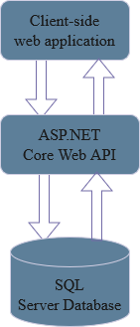
System Design
System Architecture Diagram
The system follows a 3-tier architecture:
Presentation Layer: Client-side web application.
Application Layer: ASP.NET Core Web API for business logic and HTTP endpoints.
Data Layer: SQL Server database for data storage.

Slide 9
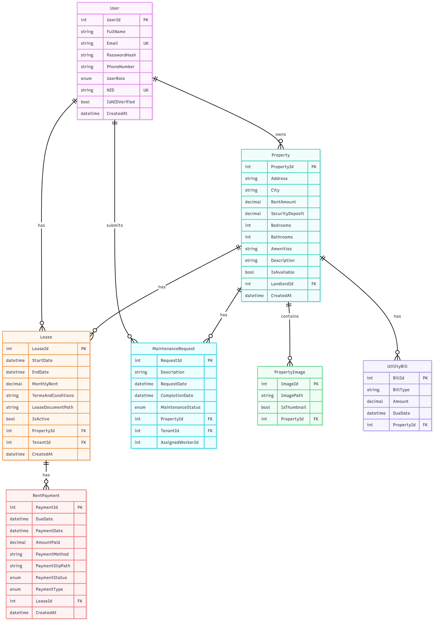
System Design
ERD

Slide 10
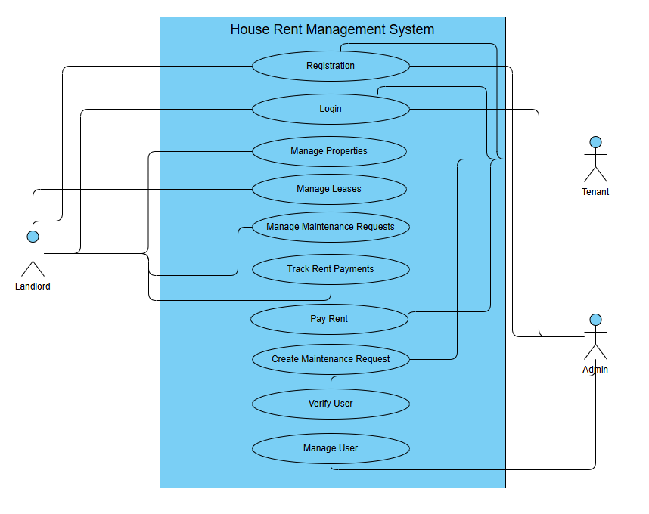
System Design
Use Case Diagram

Slide 11
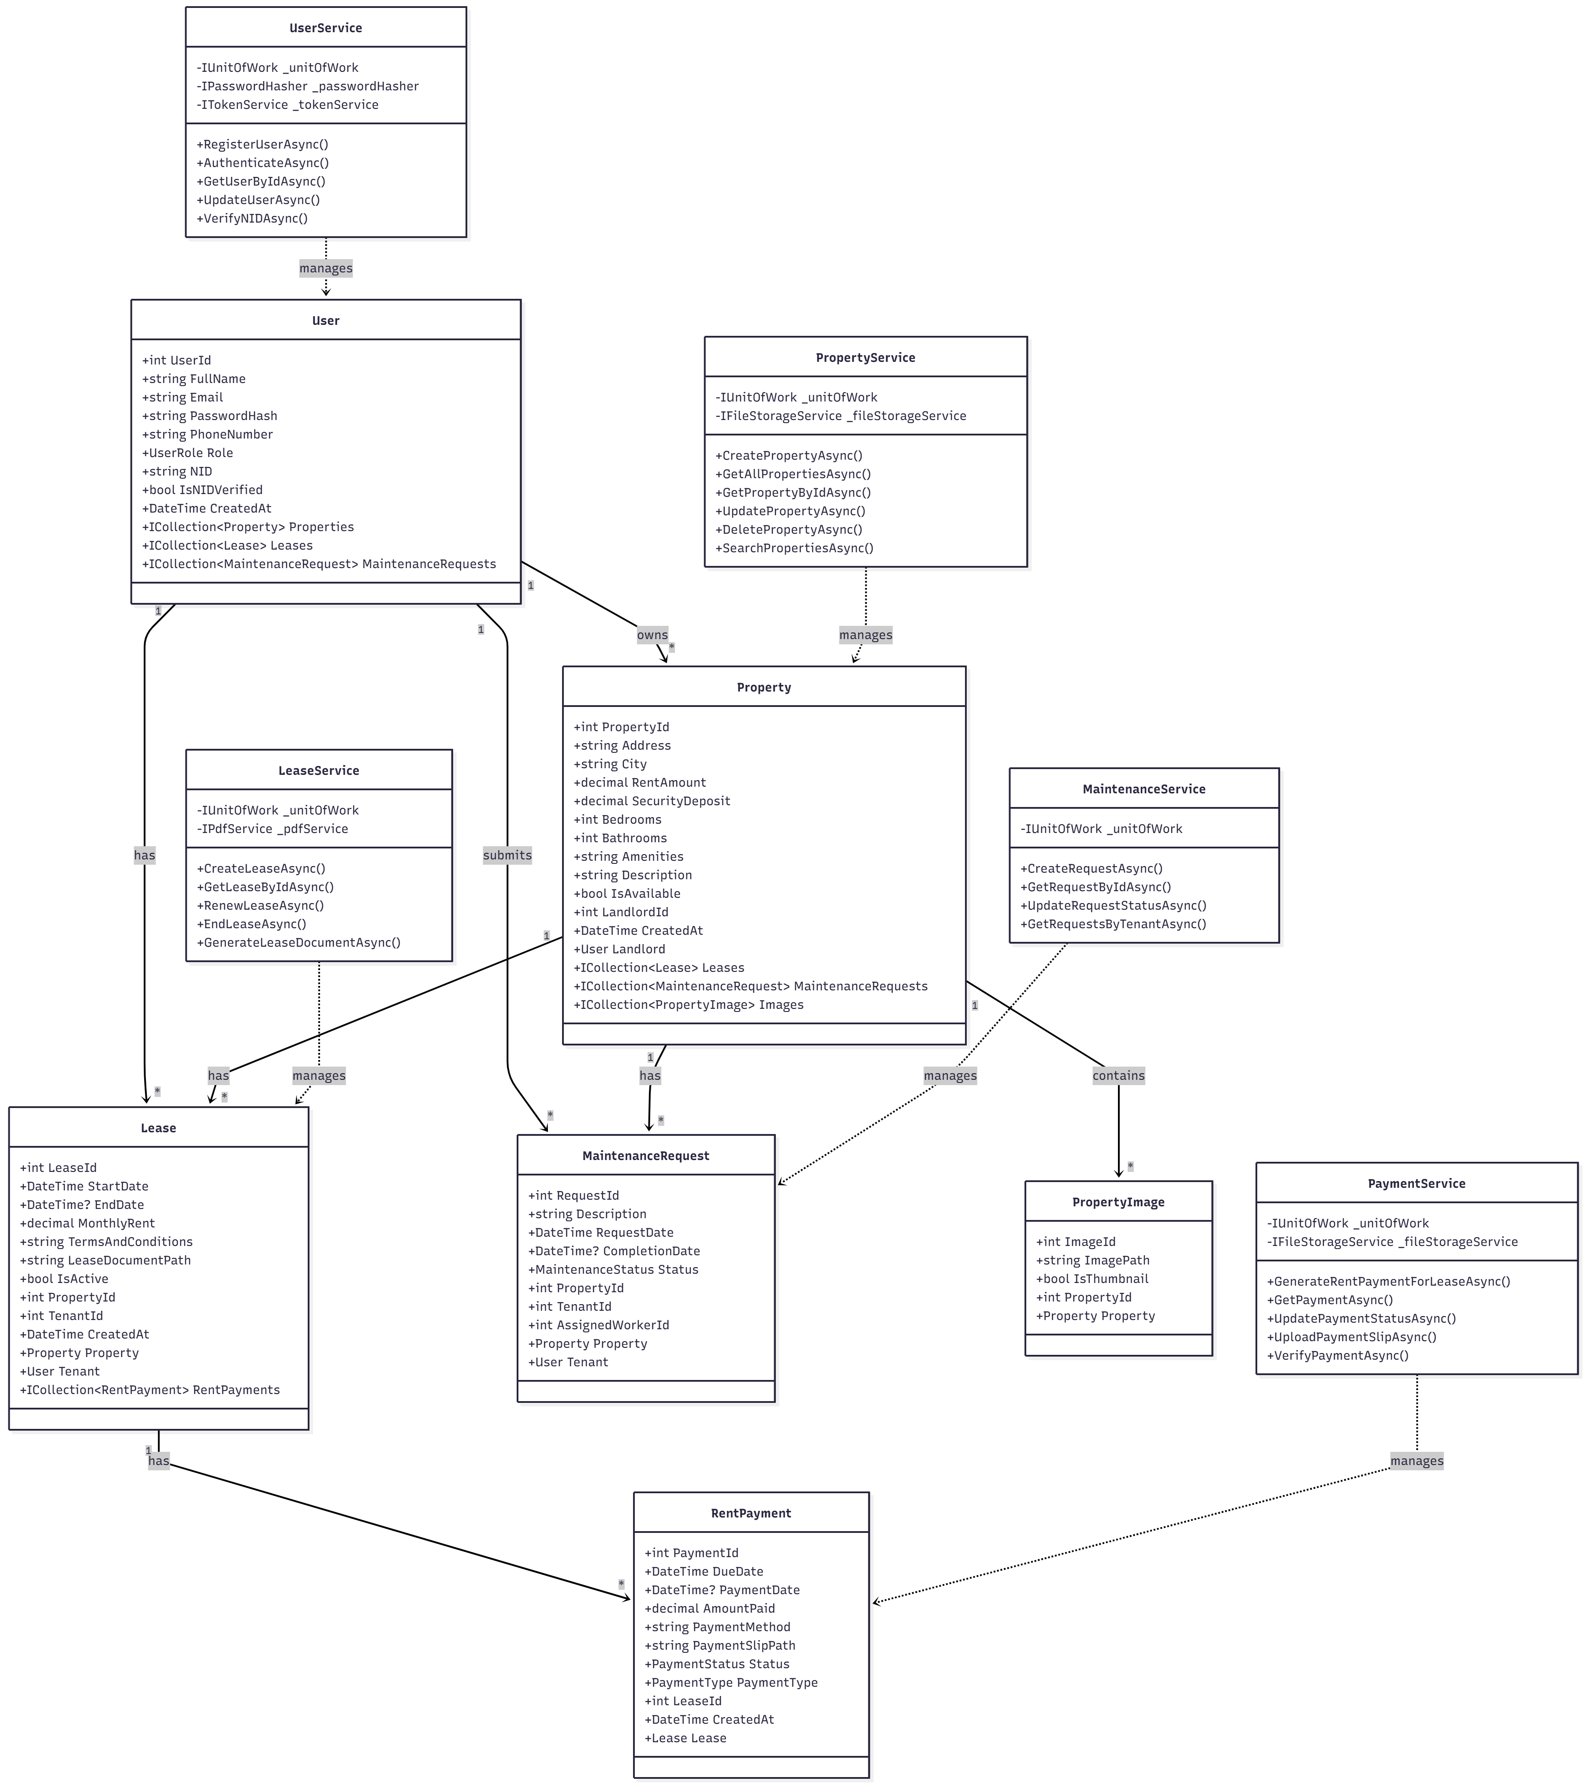
System Design
UML Class Diagram

Slide 12
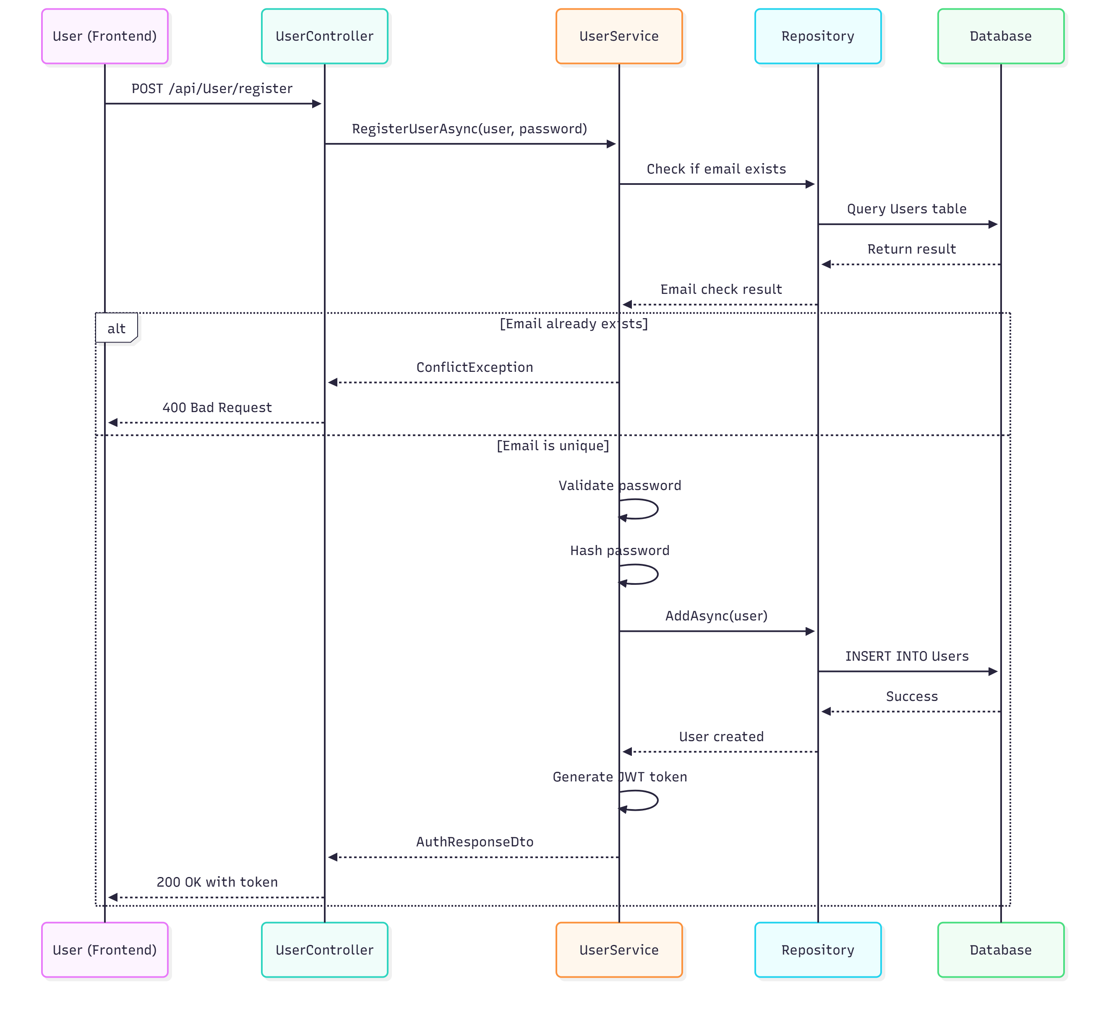
System Design
User Registration
Sequence Diagram

Slide 13
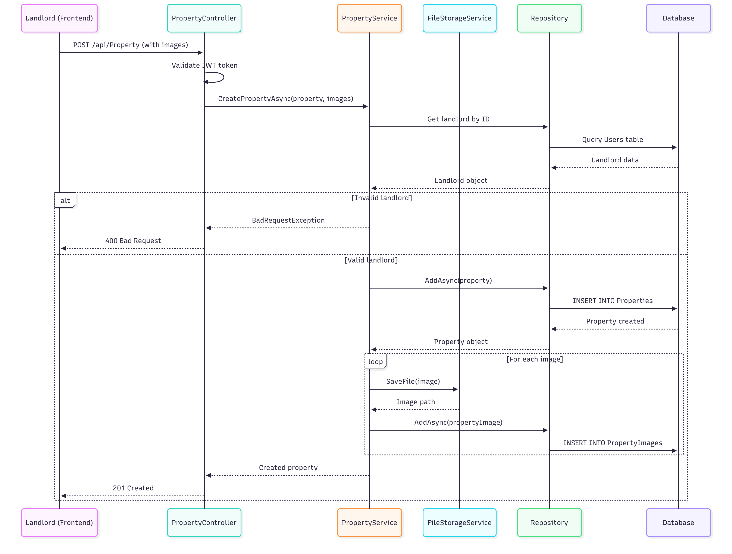
System Design
Property Creation
Sequence Diagram

Slide 14
System Design
Database Schema Overview
Users Table: Stores User ( landlord, tenant and admin) accounts and authentication details.
Properties Table: Lists rental properties.
PropertyImages Table: Property image storage.
Leases Table: Stores lease information.
RentPayments Table: Stores payment records.
MaintenanceRequests Table: Tracks maintenance requests.
Utility Bills Table: Stores utility bill history.

Slide 15
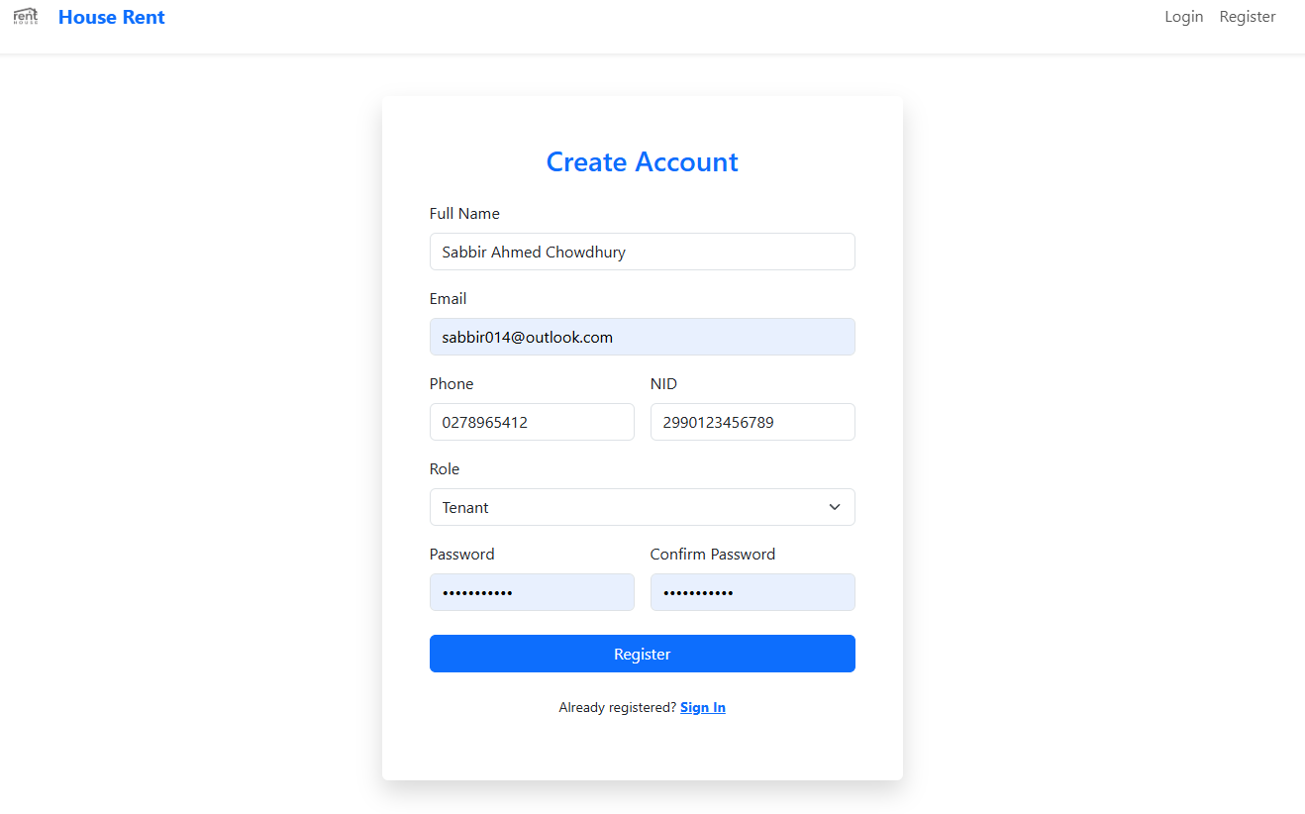
User Interface & Features

Slide 16
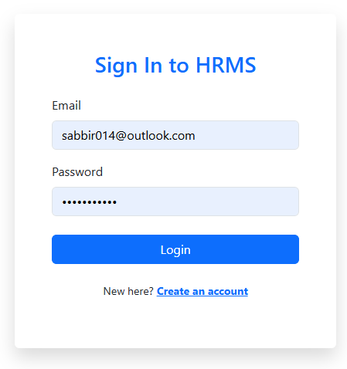
User Interface & Features

Slide 17
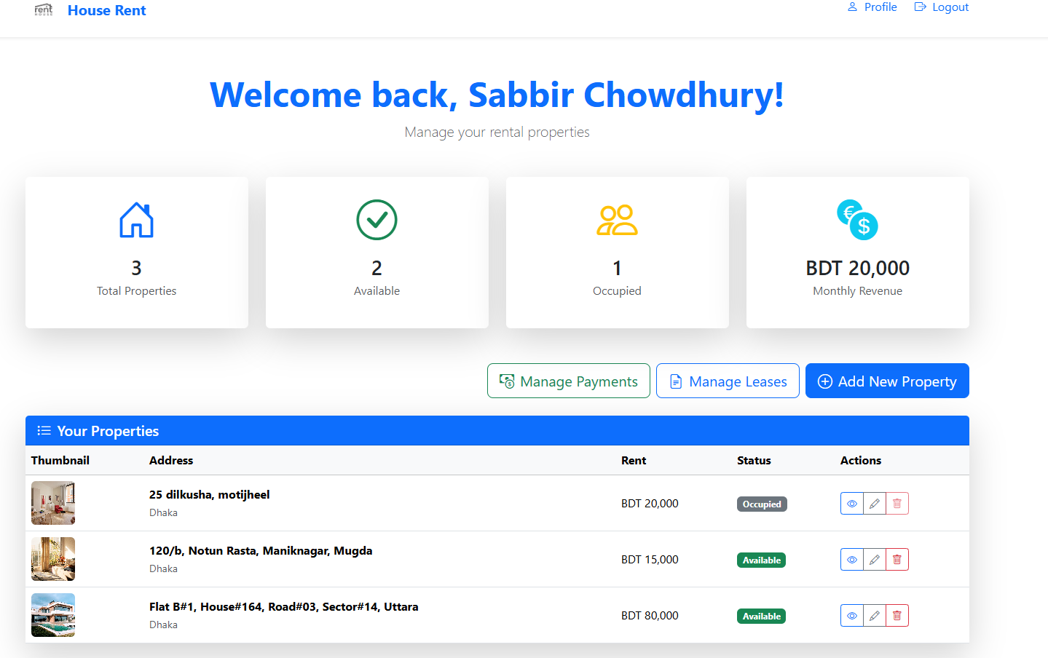
User Interface & Features

Slide 18
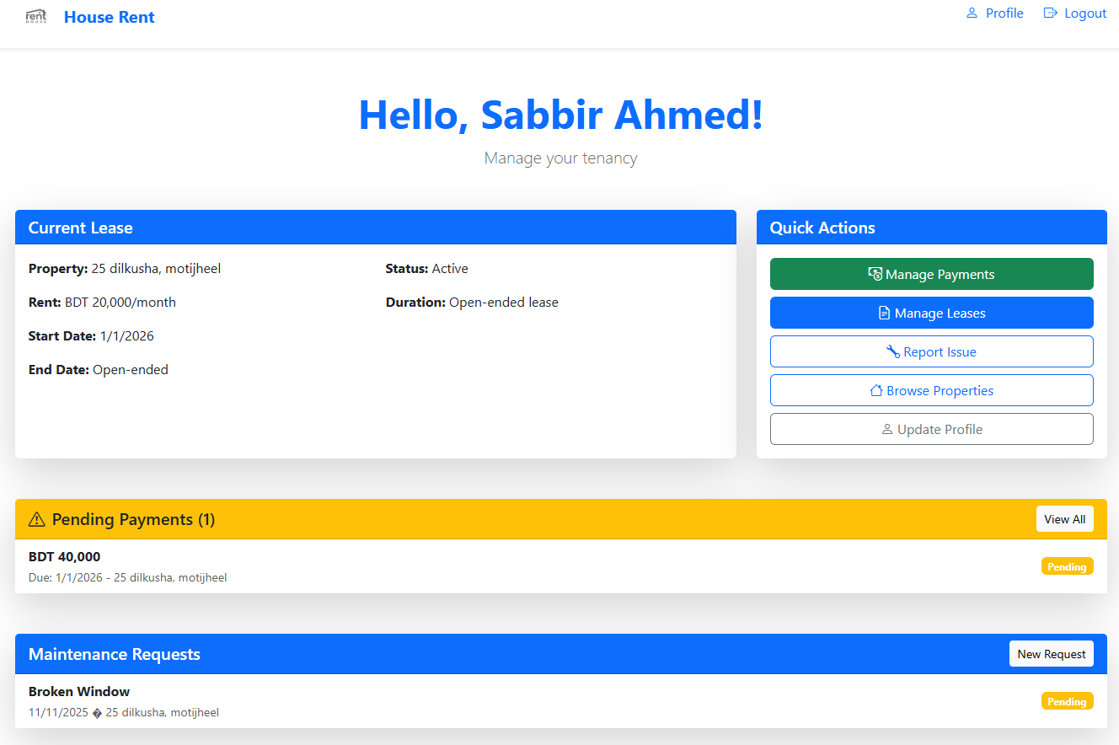
User Interface & Features

Slide 19
User Interface & Features

Slide 20
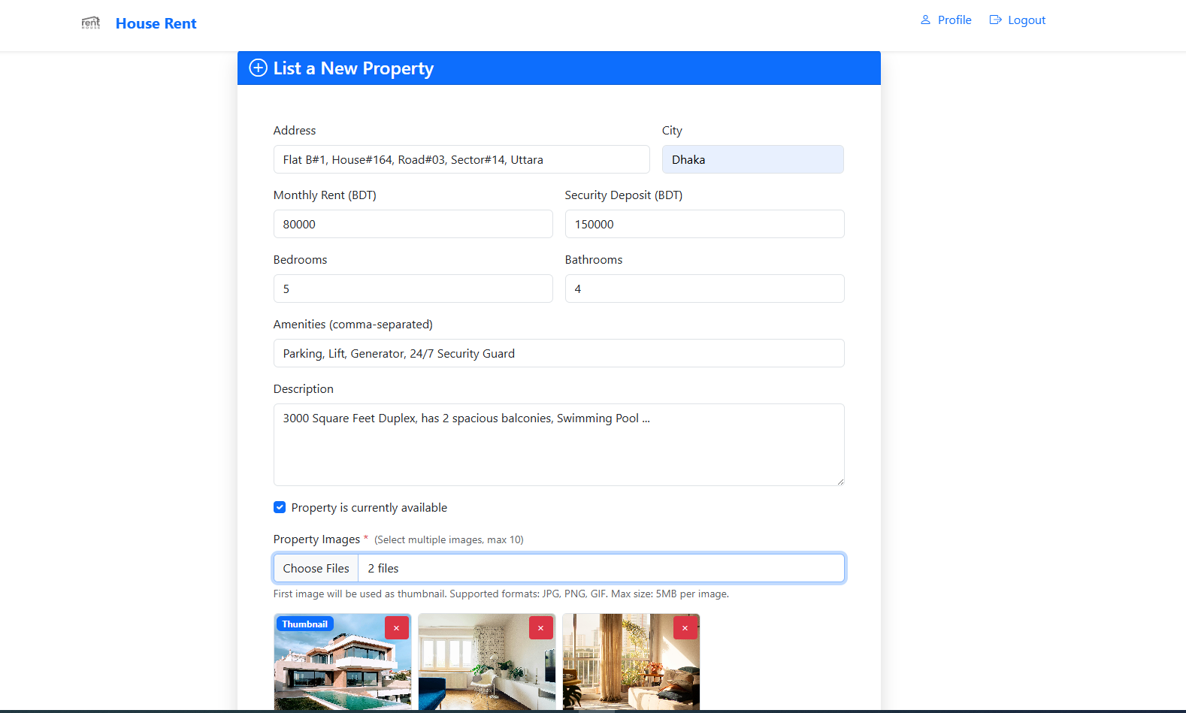
User Interface & Features

Slide 21
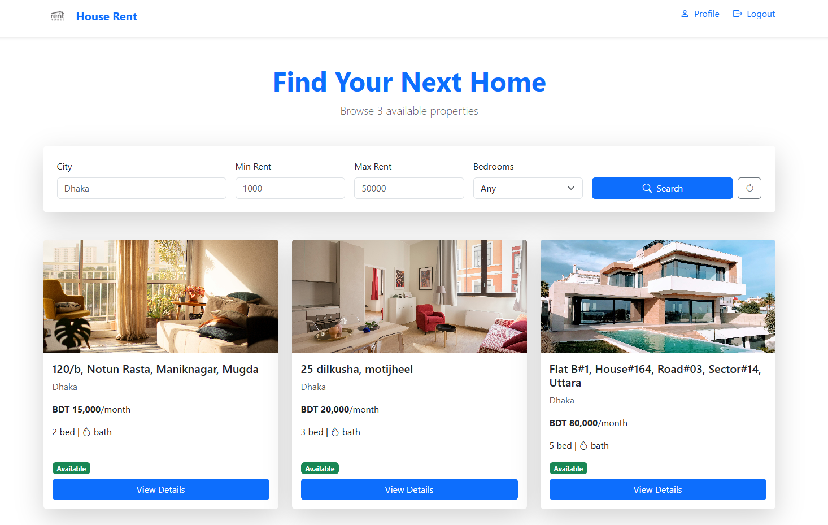
User Interface & Features

Slide 22
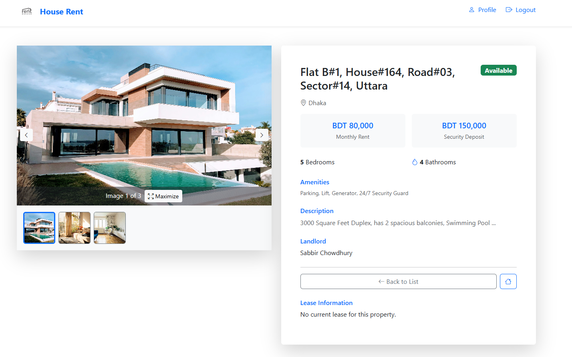
User Interface & Features

Slide 23
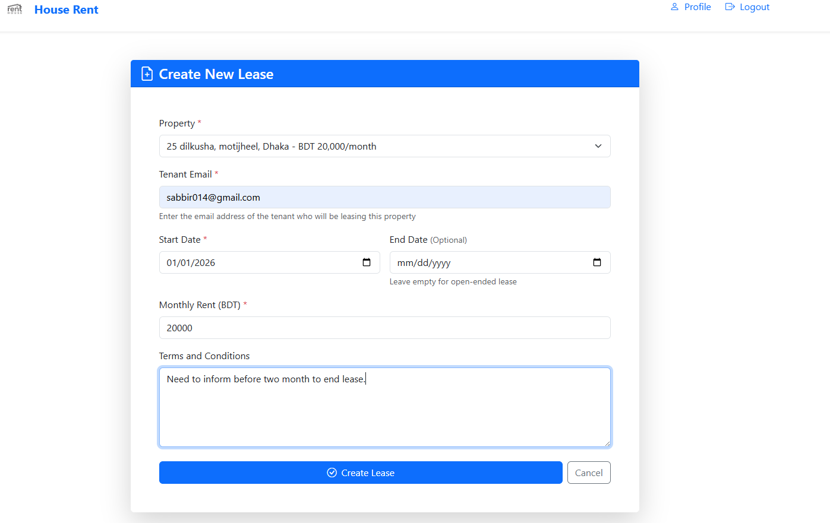
User Interface & Features

Slide 24
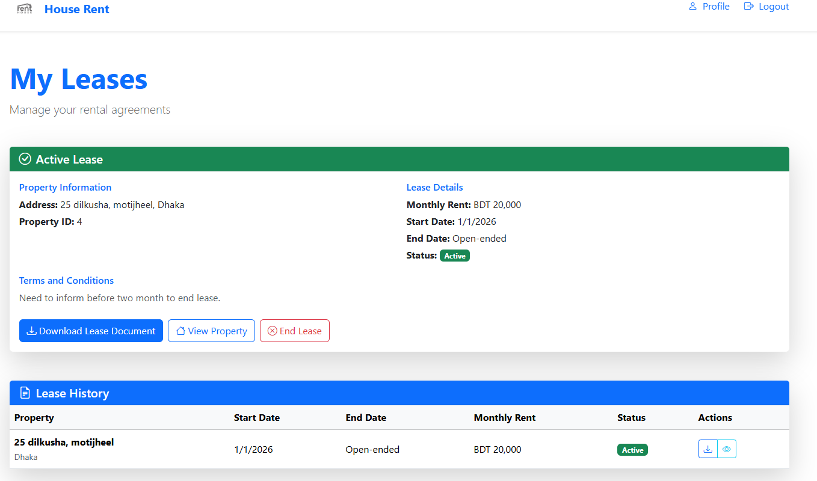
User Interface & Features

Slide 25
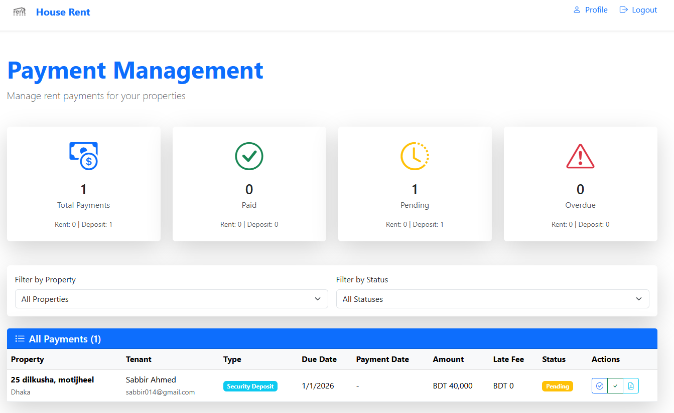
User Interface & Features

Slide 26
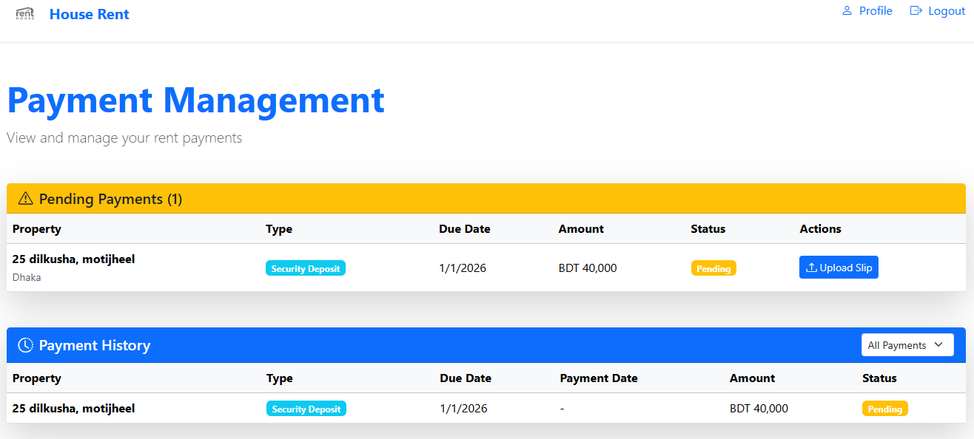
User Interface & Features

Slide 27
User Interface & Features
Key Features & Functionalities
User Authentication & Authorization
Register new users as landlords, tenants, or admins.
Users can log in with email id and password.
Role-based access control:
Admin: Manage and verify users.
Landlord: Manage houses, tenants, maintenance requests and payments.
Tenant: View assigned property, update payment and upload payment slip, and submit maintenance requests, update profile.

Slide 28
User Interface & Features
Property Management
Landlords can efficiently create and manage property listings with multiple images.
The property search functionality enables tenants to find suitable properties based on various criteria.
Lease Management
Landlords assign tenants to houses with lease start/end dates.
Generate and store lease agreements with terms and conditions.
Allow tenants/landlords to download leases in PDF format.
Landlords can end/renew leases.
Landlord and tenants can view previous lease records.

Slide 29
User Interface & Features
Rent Payment Management
The automated payment generation system eliminates manual record-keeping for monthly rent payments.
The payment tracking feature provides transparency for both landlords and tenants.
Tenants can upload payment slip.
landlords can verify and update payment statuses efficiently.
Landlords and tenants can view past payment records.
Maintenance Management
Tenants can easily submit maintenance requests.
Landlords can track and update request statuses.
Landlord can view property maintenance history.

Slide 30
User Interface & Features
Dashboard
Dashboard for landlords to view houses, rental status, payment records and maintenance records.
Tenants can view their lease, maintenance and payment records.

Slide 31
User Interface & Features
Workflow Overview
➔ Login
➔ Validate Credentials
➔ Admin Dashboard
➔ Manage Users
➔ Landlord Dashboard
➔ Manage Properties
➔ Manage Lease
➔ Manage Payments
➔ Manage Maintenance Requests
➔ Tenant Dashboard
➔ Browse Properties / Lease Records
➔ Upload Payment Slip
➔ View Payment Records
➔ Create Maintenance Requests
➔ Logout

Slide 32
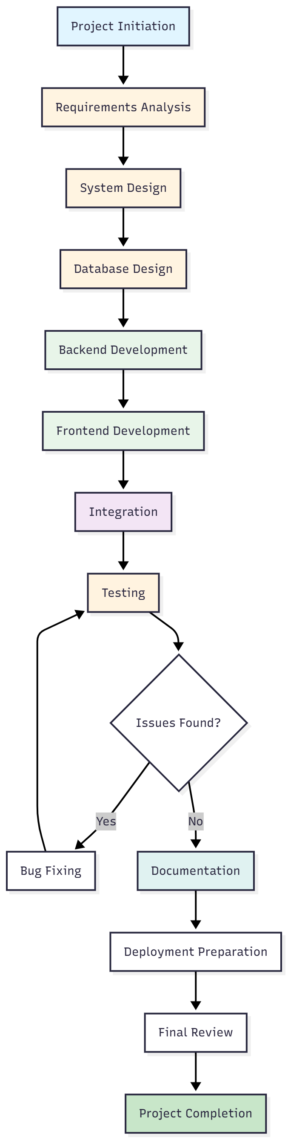
Implementation
Development Methodology
The development process followed an iterative and incremental approach, with clear phases and milestones. The workflow diagram illustrates the development lifecycle.

Slide 33
Implementation
Programming Languages & Frameworks Used
Programming Languages:
C#: Primary language used for back-end development in ASP.NET Core Web API.
JavaScript: For front-end development in React.
Frameworks:
.NET 9.0: Modern, cross-platform framework for building web APIs.
ASP.NET Core Web API: Framework for building RESTful services.
Entity Framework Core 9.0: Object-relational mapping (ORM) for interacting with the database in a more structured and efficient way.
React 19.1: For building the web site (front end).
Bootstrap 5.3: CSS framework for responsive design.
Database:
MS SQL Server for relational data storage (e.g., user, property).

Slide 34
Testing & Debugging
Types of Testing Conducted
Unit Testing: Unit tests were developed for critical business logic components, particularly service layer methods. The xUnit testing framework was used for backend unit tests.
Integration Testing: Integration tests verified the interaction between different system components (Database, API, Front End)
System Testing: System testing evaluated the complete system functionality.
Test Results
All core functionalities were successfully tested and verified:
User registration and authentication: 100% pass rate
Property CRUD operations: 100% pass rate
Lease management: 100% pass rate
Payment operations: 100% pass rate
Maintenance requests: 100% pass rate

Slide 35
Deployment & Hosting
How the software is deployed (Cloud, Local Server, Web, Mobile)
The system is currently configured for local development:
Backend: Runs on “http://localhost:5286” or “https://localhost:7194”
Frontend: Runs on “http://localhost:56127”
Database: SQL Server on local machine
File Storage: Local file system at “D:/FileStorage”
Hosting Platform
Windows Server:
IIS (Internet Information Services): Web server for hosting both frontend and backend
SQL Server: On-premises database server
Windows File Server: For file storage

Slide 36
Deployment & Hosting
Installation or Setup Process
Before installation, ensure the following prerequisites are met:
For Backend API:
.NET 9.0 SDK installed
Windows, Linux, or macOS operating system
For Frontend:
Node.js 18.0 or later
npm (comes with Node.js) or yarn package manager
Modern web browser for testing
For Database:
SQL Server instance running and accessible
Database user with appropriate permissions
Sufficient disk space for database and file storage

Slide 37
Demonstration
Live Demo of the Software
Show Key Functionalities
Walkthrough of the User Interface

Slide 38
Results & Findings
Compared to traditional manual rental management approaches, the implemented system offers significant advantages:
Automation: Automated payment generation and reminders reduce manual effort
Accessibility: Web-based access from any device with internet connectivity
Transparency: Both parties have access to relevant information and history
Efficiency: Streamlined processes reduce time required for common tasks
Accuracy: Automated calculations and validations reduce human errors
Documentation: Digital storage of documents eliminates physical file management

Slide 39
Future Enhancements
There are several areas for future enhancement and research:
Payment Gateway Integration: Integration with payment gateways would enable direct online payment processing, eliminating the need for manual payment verification.
Mobile Application Development: Native mobile applications for iOS and Android would enhance accessibility and user convenience.
Enhanced Communication Features: Integration of in-app messaging, notification systems, and document sharing would improve communication between landlords and tenants. Real-time chat functionality could replace email communication.
Advanced Search and Filtering: Enhanced search capabilities with machine learning-based recommendations could help tenants find suitable properties more efficiently.
Scalability Enhancements: Implementation of microservices architecture, caching strategies, and cloud deployment would enhance system scalability for large-scale deployments.

Slide 40

Conclusion
The House Rent Management System represents a significant step toward modernizing rental property management processes. While the current implementation addresses core requirements effectively, the identified future enhancements would further improve the system's value and applicability.
The project demonstrates that modern web technologies can be effectively applied to create practical solutions for real-world problems. The lessons learned and experiences gained during this project provide valuable insights for future software development endeavors.
The system is ready for deployment in a controlled environment and can serve as a foundation for further development and enhancement. With continued refinement and the implementation of proposed future features, the system has the potential to become a comprehensive solution for rental property management.

Slide 41
References
Microsoft. ASP.NET Core Documentation. Retrieved from https://learn.microsoft.com/en-us/aspnet/core
ReactJS. Official React Documentation. Retrieved from https://reactjs.org/docs/getting-started.html
10 Usability Heuristics for User Interface Design from https://www.nngroup.com/articles/ten-usability-heuristics/
Top 10 Web Application Security Risks from https://owasp.org/www-project-top-ten/
Fowler, M. (2002). Patterns of Enterprise Application Architecture. Addison-Wesley.
Stack Overflow Developer Survey 2023. (2023). Technology Trends in Web Development. Retrieved from https://survey.stackoverflow.co
Jones, M., Bradley, J., & Sakimura, N. (2015). JSON Web Token (JWT). RFC 7519. Retrieved from https://tools.ietf.org/html/rfc7519

Slide 42

Q&A / Thank You

